Slide 1






PRESENTATION 2026
Sales and business data cleaning and visualisation using excel
Student Name
Student Email
PRACHI THAGELA
30093@arsd.du.ac.in
Mentor Name
Uma maheshwari

Slide 2

Outline
Abstract of the Project
Problem Statement
Proposed Solution
System Architecture
Live Demo of the Project
Embedded Video of Project
Conclusion
Future Scope

Slide 3
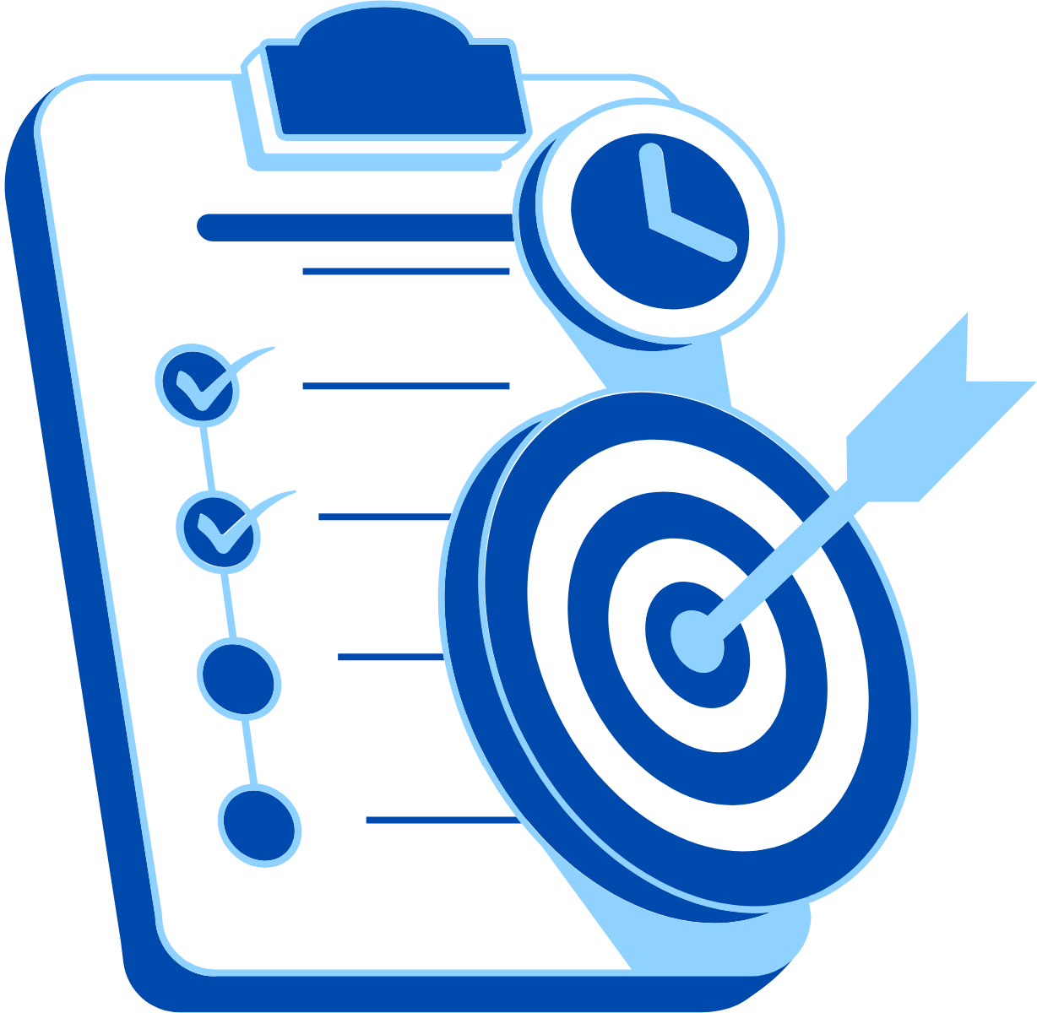
Abstract
This project focuses on addressing data inefficiencies by cleaning and analyzing raw sales data that contains errors such as duplicates, missing values, and inconsistent formatting. The objective is to transform unstructured data into a reliable and organized format using Microsoft Excel tools like formulas, pivot tables, and charts. The project aims to generate meaningful insights on key business metrics such as revenue and average order value, demonstrating how effective data cleaning and visualization can improve decision-making.

Slide 4

Problem Statement
Businesses face inefficiencies due to poor-quality sales data containing duplicates, missing values, and inconsistent formats. This makes data analysis difficult and leads to inaccurate insights and delayed decision-making. The problem affects managers and analysts who rely on clean data for business decisions. Existing approaches are often manual and error-prone. This project focuses on cleaning and analyzing sales data using Microsoft Excel to improve data accuracy and generate reliable insights.

Slide 5

Proposed Solution
The solution involves cleaning and analyzing raw sales data to remove duplicates, fix inconsistencies, and handle missing values. Using Microsoft Excel, techniques like sorting, filtering, formulas, pivot tables, and charts are applied. This structured approach improves data accuracy, enables faster analysis, and helps generate reliable insights for better decision-making.

Slide 6
System Architecture
Data Input / Source
Processing / Analysis
The data is taken from a raw sales dataset in an Excel file, containing fields like Order ID, Date, Product, Quantity, and Revenue.
The data is cleaned by removing duplicates, correcting inconsistencies, and handling missing values. It is then transformed using Excel formulas and proper formatting. Finally, pivot tables and charts are used to analyze the data and generate meaningful insights
AI / Tool Integration
Output / Dashboard
Microsoft Copilot in Excel is used to assist with formula generation, data cleaning, and quick insights. It helps automate tasks, improve accuracy, and speed up data analysis.
An Excel dashboard with key metrics, charts, and pivot tables to visualize sales data and insights clearly

Slide 7
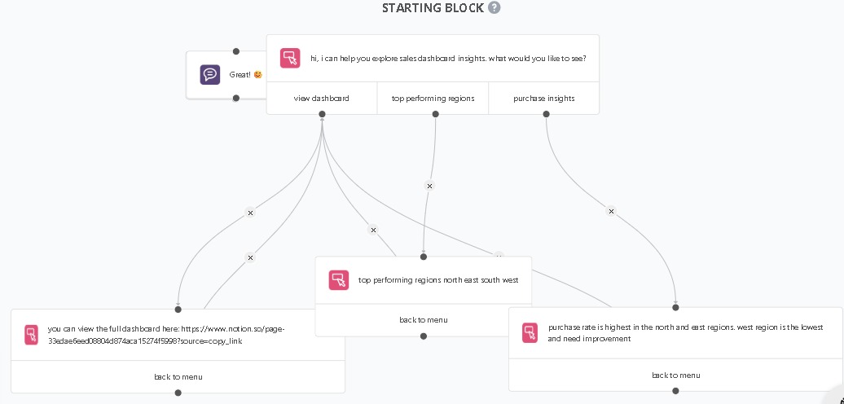
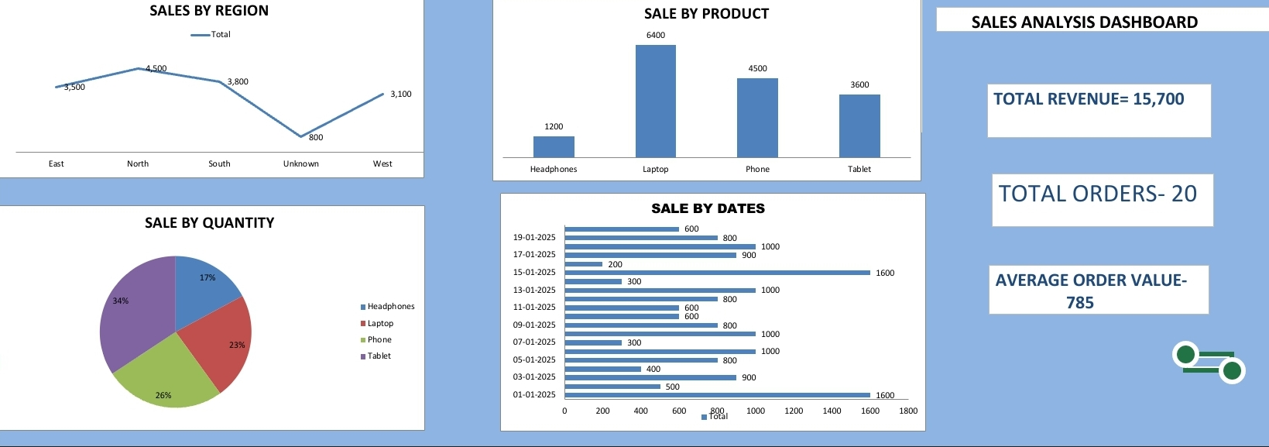
Live Demo of Project
Here's the list of some demo screenshots / features of the project:
Demo 1- Dashboard
Demo 2- formulas
Demo 3- Copilot assistance
=SUM(range) – to calculate total revenue =AVERAGE(range) – to find average order value =IF(condition, value_if_true, value_if_false) – for logical checks =VLOOKUP() / =XLOOKUP() – to fetch related data =TRIM() – to remove extra spaces =UPPER() / =LOWER() / =PROPER() – to standardize text =COUNT() / =COUNTA() – to count entries =IFERROR() – to handle errors in calculations

Slide 8
Video of Project Demo
[https://your-project-demo-link.com]
▶
[Insert your project demo video.
You can embed a video your live project.]

Slide 9
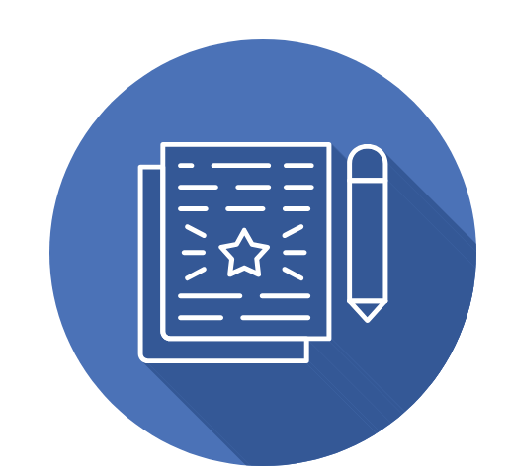
Conclusion
This project demonstrated how raw sales data can be cleaned and analyzed using Excel with Copilot. Data inconsistencies were removed, and meaningful insights such as sales trends and top-performing products were identified using Pivot Tables and charts.
All objectives were successfully achieved, and the use of AI tools improved efficiency and accuracy. The project highlights the importance of data cleaning and its role in effective business decision-making.
CONCLUSION

Slide 10

Future Scope
Use of Microsoft Copilot in Excel for automated data cleaning and insights Integration with real-time data sources ,Creation of interactive dashboards using advanced Excel features. Addition of customer data and profit analysis.
This project has the potential to evolve into a scalable, AI-powered business analytics system with advanced visualization and predictive capabilities

Slide 11
Thank You
AICW Fellowship | Student Project Presentation 2026
LinkedIn | Edunet Foundation

